Slide 1
ECE201H1 F Magellan Info Session
Ravi Adve
Associate Chair, Undergraduate Studies
Department of Electrical and Computer Engineering
Leanne Dawkins
Program Manager and Academic Advisor
Department of Electrical and Computer Engineering
Neena Peterson and Dharsha Sundarampillai
Student Advisors
Department of Electrical and Computer Engineering

Slide 2
Outline
Undergraduate Office
Learning Strategies for Academic Success
Flexible Curriculum
Magellan Course Software
CEAB Requirements
How To Get Help?

Slide 3
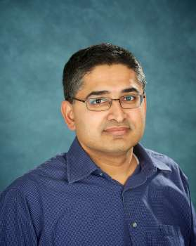
What I do …
Associate Chair, Undergraduate Studies
Oversee and manage delivery of the undergraduate program
Manage and facilitate annual undergraduate teaching assignments for all ECE courses
Provide student academic support

Slide 4
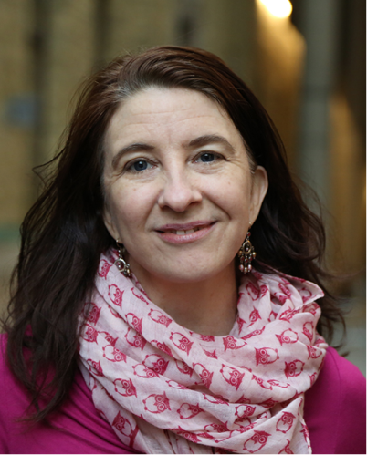
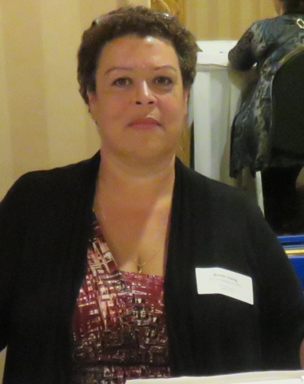
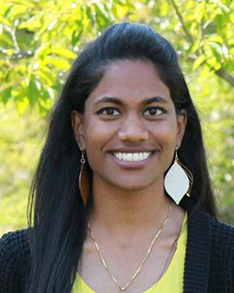
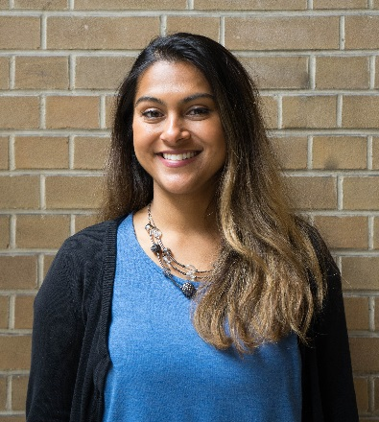
ECE Undergraduate Advising Team
Leanne Dawkins
Program Manager
and Advisor
Lina McDonald
Undergraduate Program & Payroll Officer
Karen Irving (On Leave)
Student Advisor
Dharsha Sundarampillai
Student Advisor
Neena Peterson
Student Advisor
Notes:
Leanne’s responsibilities:
Provides student counselling, in person, via e-mail or by telephone, including Foreign Exchange students
Organizes, maintains and researches curriculum & calendar updates
Schedules all undergraduate courses
Supports Faculty Council academic representatives
Assists the UG Chair with teaching assignments, new staff direction & policy formation
Monitors degree requirements, oversees convocation, tracks failures, etc.
Jayne’s responsibilities
Manages undergraduate leadership initiatives
Assists with student counselling
Neena’s and Karen’s responsibilities
Front-line support – responds to general inquiries by phone/email/in person
Advises students on course selection process, Magellan, and graduation requirements
Maintains and processes 600 hours practical experience certificates
Processes adds/drops, section changes, etc. on ROSI
Maintains central email address for undergraduate office functions

Slide 5
Notes:
What success really looks like is different than what we see – there will be ups an downs, and failures and lots of hard work, which we don’t often talk about
-Its easy to think everybody else is doing better or school is easier for them because they are doing well
-but you are never really aware of the failures or dissapointment another student experiences,
-it can be very stressful to compare yourself to others, or to define success only in terms of grades, and not be able to see how you may have success in other parts of your life

Slide 6
Resources
GEARS (uoft.me/gears)
ACE Workshop Series (hyperlinked)
Individual appointments with:
Academic Advisors
Learning Strategist
Health and Wellness Counsellor
Accessibility Advisor
Librarian
We’re here to help!

Slide 7
Know the Calendar
The Academic Calendar is your contract with the university. Know your responsibilities and rights, and all rules governing your undergraduate studies:
https://engineering.calendar.utoronto.ca/
(Starting from Pg. 182)

Slide 8
Course Selection
All ECE courses are grouped by areas of study (Areas 1-6, Science/Math)
Some courses may appear in more than one area, but when taken can only apply to ONE requirement.
You can specify the courses you wish to select, and the year and the term in which you wish to take it (your 3rd and 4th year)
Terms are noted as follows:
20219 (2021 year + 9 Fall, i.e., September-December)
20221 (2022 year + 1 Winter, i.e., January-April)
20225 (2022 year + 5 Summer, i.e., May-August)

Slide 9
ECE Flexible Curriculum, 3rd & 4th Year
Area Kernel Courses (4 required from 4 different areas) | AREA KERNEL | AREA KERNEL | AREA KERNEL | AREA KERNEL
Depth Courses (4 required - 2 courses from 2 areas chosen above) | DEPTH | DEPTH | DEPTH | DEPTH
Technical Electives (Does not need to be from the areas you selected for Kernal/Depth requirements) | TECHNICAL Elective | TECHNICAL Elective | TECHNICAL Elective | SCIENCE/MATH Elective
Complementary Studies Electives* *two must be HSS | CS Complementary Studies Elective | CS Complementary Studies Elective | HSS Humanities & Social Studies Elective | HSS Humanities & Social Studies Elective
Core Courses & Free Elective | ECE496Y Design Project |  | ECE472 Engineering Economic Analysis & Entrepreneurship | FREE Elective
Notes:
There are 19 upper-year courses in total including technical electives, a full-year Capstone course, one free elective, one science/math, as well as four CS/HSS courses (we recommend one per term).

Slide 10
What is not Flexible
ECE472H1- Engineering Economics (can be completed in any upper-year term)
ECE496Y1/APS490Y1/BME498Y- Capstone Design (must be completed in your final year)
Must meet Canadian Engineering Accreditation Board (CEAB) requirements
Magellan can help you with this
Must complete pre-requisites for advanced level courses
There may be
enrolment limitations,
CEAB limitations,
pre-requisite requirements

Slide 11
Breadth and Depth Requirement
The courses taken here determine the degree designation (EE or CE). Depending on the courses you select, you may also have the choice to select CE/EE designation
AREA A
AREA B
DEPTH
DEPTH
Depth Requirement:
4 Courses
DEPTH
DEPTH
AREA
KERNEL
AREA
KERNEL
AREA C
AREA D
AREA
KERNEL
AREA
KERNEL
Breadth Requirement: 4 distinct Areas

Slide 12
3rd and 4th Year Courses (Areas 1 – 4) - EE
Area 1 Photonics and Semiconductor Physics | ECE335 – Intro to Electronic Devices | ECE318 – Fundamentals of Optics
 | ECE442 – Intro to Micro- and Nano-Fabrication Technologies ECE427 – Photonic Devices | ECE330 – Quantum & Semiconductor Physics ECE469 – Optical Communications & Networks ECE437 – VLSI Technology
Area 2 Electromagnetics and Energy Systems | ECE314 – Fund. Of Electrical Energy Systems | ECE320 – Fields and Waves
 | BME595 – Medical Imaging ECE424 – Microwave Circuits ECE514 – Power Electronics: Converter Topologies | ECE413 – Energy Systems & Distributed Generation ECE422 – Radio and Microwave Wireless Systems ECE463 – Electric Drives ECE533 – Power Electronics: Switch-Mode Power Supplies
Area 3 Analog and Digital Electronics | ECE331 – Analog Electronics | ECE334 – Digital Electronics
 | ECE424 – Microwave Circuits ECE430 – Analog Integrated Circuits ECE446 – Sensory Communication | ECE437 – VLSI Technology ECE412 – Analog Signal Processing Circuits ECE532 – Digital Systems Design
Area 4 Control, Communications and Signal Processing | ECE311 – Dynamics Systems & Control | ECE316 – Communication Systems
 | BME445 – Neural Bioelectricity BME595 – Medical Imaging ECE302 – Probability & Applications ECE410 – Linear Control Systems ECE417 – Digital Communication ECE431 – Digital Signal Processing ECE446 – Sensory Communication ECE537 – Random Processes | ECE411 – Real-Time Computer Control ECE421 – Introduction to Machine Learning ECE422 – Radio and Microwave Wireless Systems ECE462 – Multimedia Systems ECE464 – Wireless Communication ECE469 – Optical Communications & Networks ECE470 – Robot Modeling and Control ECE516 – Intelligent Image Processing MIE331 – Physiological Control Systems

Slide 13
3rd and 4th Year Courses (Areas 5 – 6) - CE
Area 5 Computer Hardware & Computer Networks | ECE361 – Computer Networks I | ECE342 – Computer Hardware
 | ECE302 – Probability and Applications ECE461 – Internetworking ECE466 – Computer Networks II ECE469 – Optical Communications & Networks ECE537 – Random Processes | ECE462 – Multimedia Systems ECE464 – Wireless Communication ECE532 – Digital Systems Design ECE552 – Computer Architecture ECE568 – Computer Security
Area 6 Software | ECE344 – Operating Systems | ECE345 – Algorithms & Data Structures
 | ECE326 – Programming Languages ECE444 – Software Engineering I ECE467 – Compilers & Interpreters ECE448 – Biocomputation ECE454 – Computer Systems Programming | CSC343 – Introduction to Databases CSC418 – Computer Graphics ECE419 – Distributed Systems ECE461 – Internetworking ECE568 – Computer Security
3rd and 4th Year Courses (Science/Math)
Science/Math Electives | ESC384 – Partial Differential Equations BME455 – Cellular & Molecular Bioengineering II CHE353 – Engineering Biology CIV220 – Urban Engineering Ecology CIV300 – Terrestrial Energy Systems ECE302 – Probability and Applications ECE367 – Matrix Algebra and Optimization | BME440 – Biomedical Engineering Tech and Investigation CHE354 – Cellular and Molecular Biology MIE331 – Physiological Control Systems ECE368 – Probabilistic Reasoning ECE448 – Biocomputation ECE537 – Random Processes

Slide 14
Example of 3rd & 4th Year Course Selection
3F | AREA KERNEL | AREA KERNEL | SCI/MATH | TECH Elective | CS Complementary Studies Elective
3W | AREA KERNEL | AREA KERNEL | DEPTH | ECE472 Engineering Economics | CS Complementary Studies Elective
4F | DEPTH | DEPTH | TECH Elective | Capstone | HSS Humanities & Social Studies Elective
 |  |  |  |  | HSS Humanities & Social Studies Elective
4W | FREE Elective | DEPTH | TECH Elective

Slide 15
Degree Designation Depends on Kernel/Depth Courses
Kernel A | Depth A1 | Depth A2 | Kernel B | Depth B1 | Depth B2 | Kernel C | Kernel D | CE
Kernel A | Depth A1 | Depth A2 | Kernel B | Depth B1 | Depth B2 | Kernel C | Kernel D | CE
Kernel A | Depth A1 | Depth A2 | Kernel B | Depth B1 | Depth B2 | Kernel C | Kernel D | EE
Kernel A | Depth A1 | Depth A2 | Kernel B | Depth B1 | Depth B2 | Kernel C | Kernel D | EE
Kernel A | Depth A1 | Depth A2 | Kernel B | Depth B1 | Depth B2 | Kernel C | Kernel D | EE
Kernel A | Depth A1 | Depth A2 | Kernel B | Depth B1 | Depth B2 | Kernel C | Kernel D | EE
6 combinations are possible.
Areas
1 – 4
(EE)
Areas
5 or 6
(CE)
Key:

Slide 16
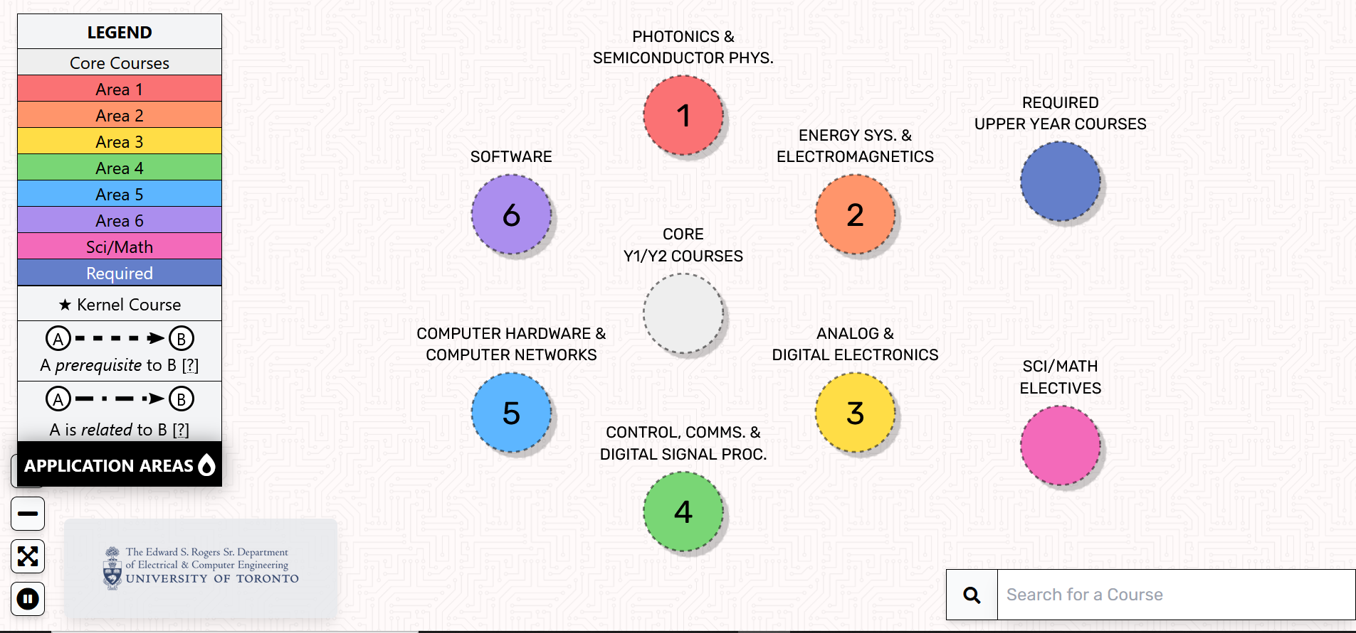
IRIS
https://ececourses.ece.utoronto.ca/
Mapping tool for ECE students, used to visualize connections between courses and highlight application areas, to aid in course selection.

Slide 17
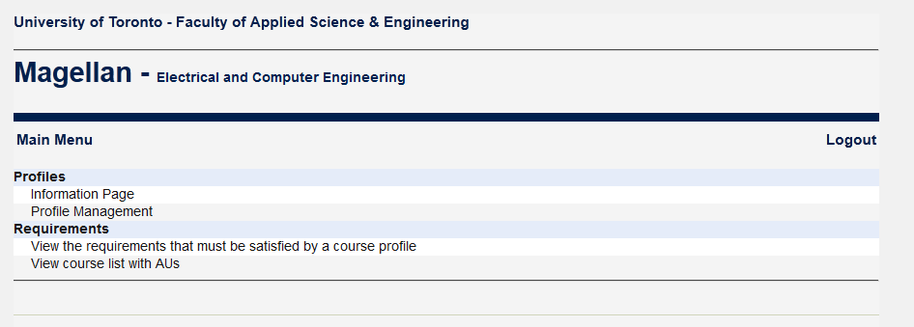
Magellan Course Selection Software
https://www.ece.utoronto.ca/undergraduates/programs/magellan/
An in-house software developed to help students choose 3rd and 4th year courses
Online tool, highly intuitive. Just choose and click.

Slide 18
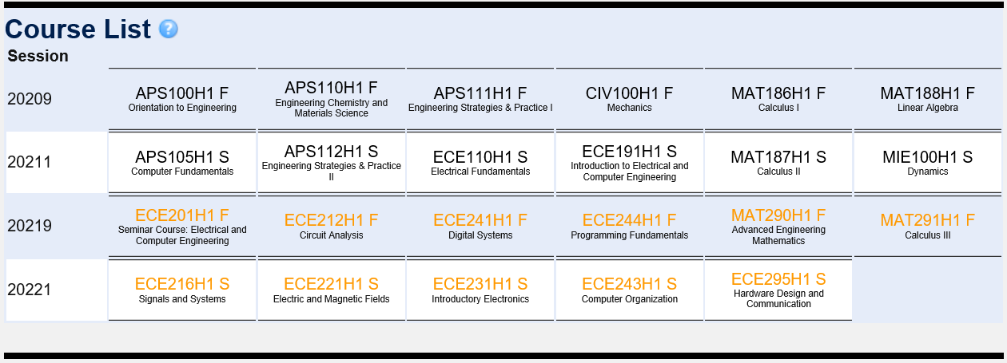
Core Requirements (1st & 2nd Years)

Slide 19
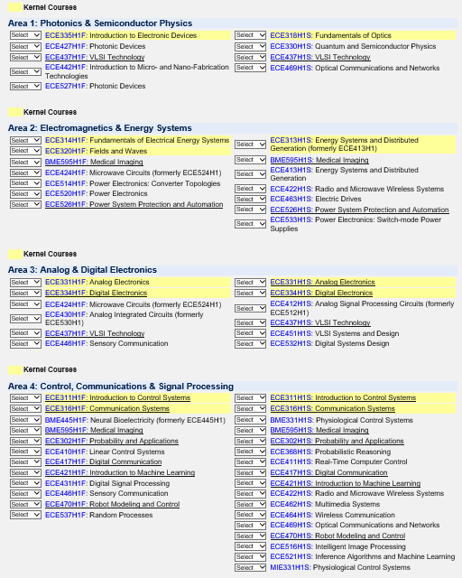
Choosing Courses on Magellan

Slide 20
Saving a Profile
After evaluating a profile, if you are satisfied with it, click the “Save profile” button
If you wish to continue editing the profile, click on “Edit profile” button and continue editing
Always remember that you have to “Save” the profile

Slide 21
Evaluating a Profile
Once your profile has been created, click the “Evaluate” button and review the profile
The system automatically computes all possible alternatives to check if your profile meets both the ECE program and CEAB requirements*
The software will identify potential problems
The software will also determine whether you qualify for the CE or EE degree
*CEAB AU’s are reviewed and updated (where necessary) on an annual basis. Make sure that you review your Main Profile to verify that these changes have not affected your requirements.

Slide 22
Your Course Profiles
Your course selection profiles include:
A Main Profile that will be used for your pre-registration
Several supplementary profiles that you experiment with (up to 30+ profiles)
Ultimately you must identify one of your profiles as your “main profile”
Due January 30, 2022 at 11:59pm EST. After that, Main Profile is LOCKED
NOTE: In July, ECE courses on valid Main Magellan profiles will be uploaded to your ACORN timetable (ECE course ONLY)
Due to course flexibility in our program, a conflict-free timetable is not guaranteed.
When ACORN opens for registration, changes can be made to your timetable (if space is available).
Notes:
SV to stress importance of using magellan for:
Preregistration numbers: Scheduling of sections, classrooms, etc is based on preregistration #s.
Planning ahead: Ensuring you meet program and CEAB requirements to be eligible to graduate

Slide 23
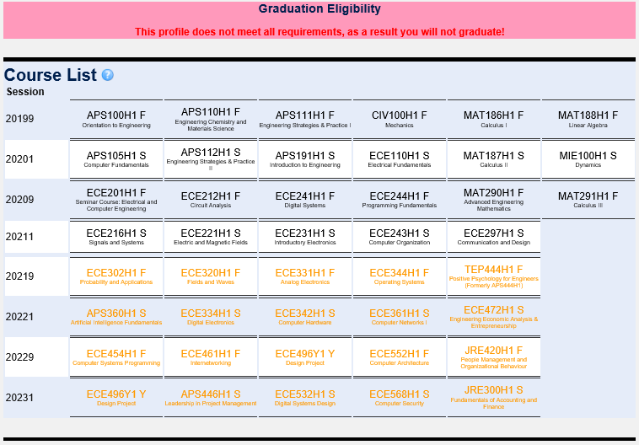

Slide 24
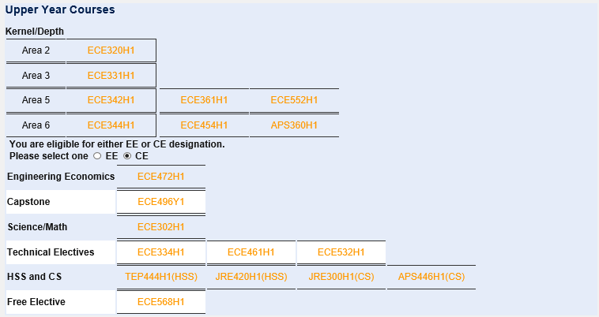
ECE Requirements
Notes:
Kernel/Depth examples only

Slide 25
CEAB Requirements
Canadian Engineering Accreditation Board
Established by the Canadian Council of Professional Engineers (CCPE) in 1965 to accredit undergraduate engineering programs
Ensures that academic requirements are met
Important for your eventual registration as a professional engineer
CEAB Curriculum Content Requirements
Engineering Science (ES)
Engineering Design (ED)
Natural Science (NS)
Mathematics (MATH)
Complementary Studies (CS)

Slide 26
CEAB Requirements : Magellan Checks

Slide 27
Links for CS/HSS courses
Complementary Studies (CS) Electives
http://undergrad.engineering.utoronto.ca/academics-registration/electives/complementary-studies-cs-electives/
Humanities & Social Science (HSS) Electives
http://undergrad.engineering.utoronto.ca/academics-registration/electives/humanities-social-science-hss-electives/

Slide 28
Fulfilling Requirements
Breadth/depth requirements
CEAB requirements
Science/Math requirement
Technical Electives and one acceptable Free Elective
Complementary/Humanities Studies
Pre-requisite and co-requisite requirements
Core Upper Year Courses: Capstone & ECE472H1

Slide 29
How to get help/more info?
Undergraduate Office: SFB600
Live Chat can be accessed through the Engineering Advising Portal. Mon – Fri 8:45am – 4:30pm
Drop-In Hours: Monday to Friday (8:45 am – 4:30 pm) Email: askece@ecf.utoronto.ca Remember to include your name; Student #; CE or EE program
Health & Wellness Supports in Engineering https://undergrad.engineering.utoronto.ca/advising-and-wellness/health-wellness/
Engineering Learning Strategist https://undergrad.engineering.utoronto.ca/advising-and-wellness/learning-skills-strategist/
Faculty Calendar https://engineering.calendar.utoronto.ca/
ECE Undergraduate Announcements – sent through the ECE Undergraduate Quercus page.
Magellan course selection software
https://magellan.ece.toronto.edu/
Engineering Minors
http://undergrad.engineering.utoronto.ca/academics-registration/minors-certificates/
Scholarship Profile- Fill it out!
https://portal.engineering.utoronto.ca/welcome.asp
NSERC-UTEA and Faculty Summer Research Awards
https://www.ece.utoronto.ca/undergraduates/scholarships/ (updated in January for the upcoming summer)
Curriculum Matters Committee
Program Advisors (list available from the ECE Undergraduate Office)

Slide 30
Reminder: If you do not have a design course on your schedule for next term, OR if you would like to change your design ECE295/297 option, complete the Google form by Dec.1, 2021.
https://forms.gle/PtQTdddG4bD9JkpA7

